Slide 1
System Design Case Studies
Ayan Sengupta

Slide 2
Hall of fame references

Slide 3
Functional vs. Non-functional Requirements
Functional Requirements : what a system is supposed to do?
Non-Functional Requirements : They are related to the quality attributes of the system.
In System Design Interviews
When you're in a system design interview, here's how you can handle these requirements:
Clarify Requirements: Start by asking questions to understand both functional and non-functional requirements. Interviewers often leave these vague to see if you'll probe for more details.
Prioritize: Not all requirements are equally important. Identify which ones are critical for the system’s success.
Trade-offs: Discuss trade-offs related to different architectural decisions, especially concerning non-functional requirements. For example, a system highly optimized for read operations might have slower write operations.
Use Real-World Examples: If you can, relate your points to real-world systems or your past experiences. This shows practical understanding.
Balance: Ensure you're not focusing too much on one type of requirement over the other. A well-rounded approach is often necessary.

Slide 4
Back-of-the-Envelope Estimations
Load estimation: Predict the expected number of requests per second, data volume, or user traffic for the system. Example : 100 million DAU * 10 posts/user = 1 billion posts/day. 1 billion posts/day / 86,400 seconds/day ≈ 11,574 requests/second
Storage estimation: Estimate the amount of storage required to handle the data generated by the system. Example : 500 million users * 2 photos/user * 2 MB/photo = 2,000,000,000 MB/day
Bandwidth estimation: Determine the network bandwidth needed to support the expected traffic and data transfer. Example : 10 million users * 4 Mbps = 40,000,000 Mbps
Latency estimation: Predict the response time and latency of the system based on its architecture and components.
Resource estimation: Estimate the number of servers, CPUs, or memory required to handle the load and maintain desired performance levels. Example :
Example : We are designing a web application that receives 10,000 requests per second, with each request requiring 10ms of CPU time.
Total CPU time per second: 10,000 requests/second * 10ms/request = 100,000ms/second.
Assuming each CPU core can handle 1,000ms of processing per second, the number of cores required would be: 100,000ms/second / 1,000ms/core = 100 cores

Slide 5
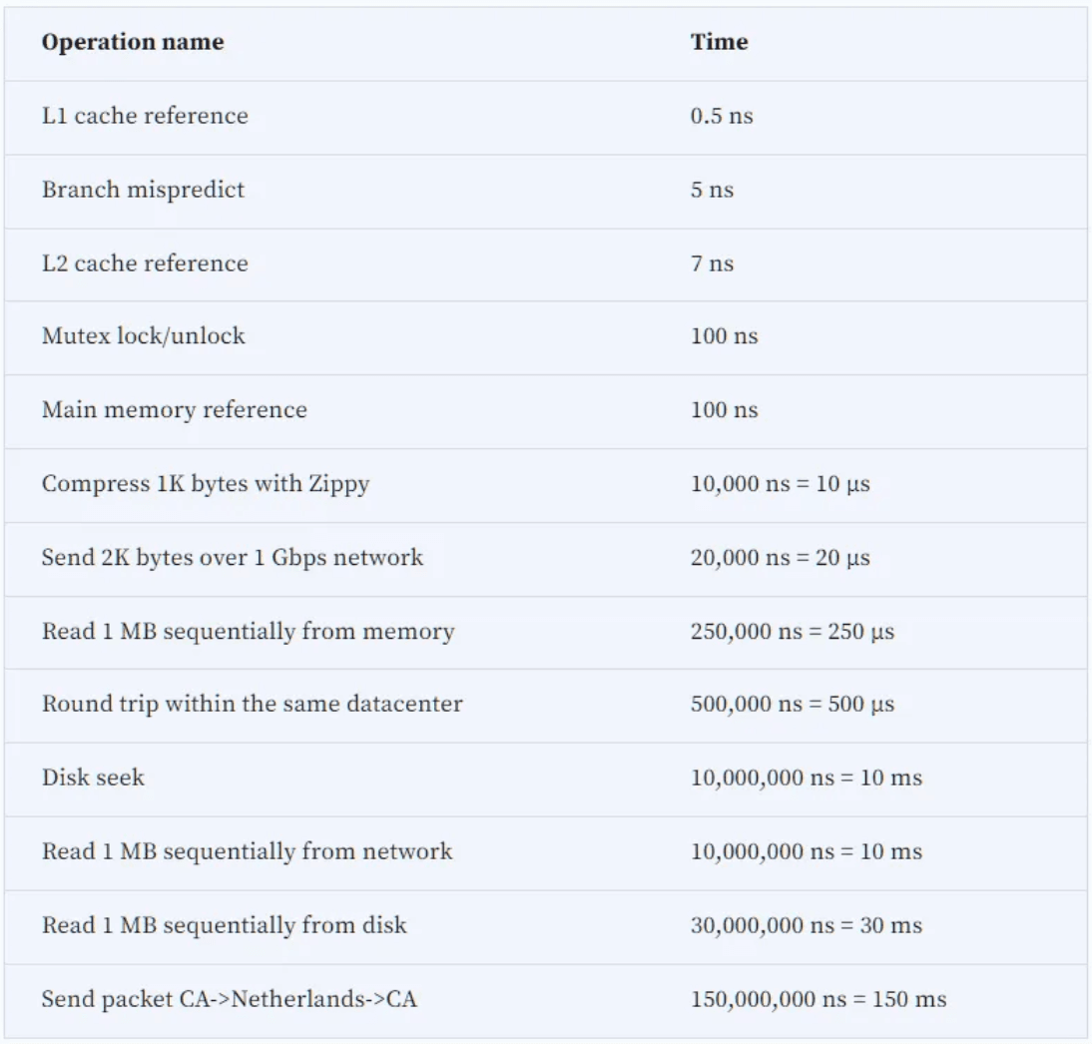
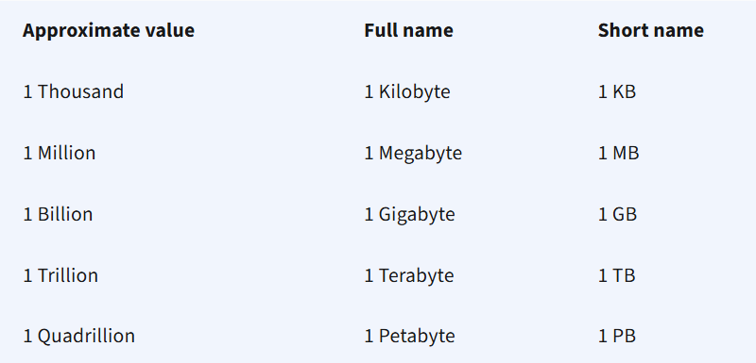
Some useful metrics

Slide 6
Key Characteristics of Distributed Systems
Scalability, Reliability, Availability, Efficiency, and Manageability (SAREM)
Scalability is the capability of a system, process, or a network to grow and manage increased demand.
Reliability refers to the ability of a system to continue operating correctly and effectively in the presence of faults, errors, or failures. A related concept is Fault Tolerance, which is the system’s ability to continue operating (possibly at a reduced level) even when one or more of its components fail.
 | Reliability | Fault Tolerance
Scope | focuses on the end-to-end correctness and consistency of the entire system’s operation over time. | focuses on the system’s ability to continue operating when individual components fail.
Perspective | is primarily a user-centric concept: Can the system consistently meet the user’s expectations over time? | is more of a system-centric concept: How does the system handle internal failures or component breakdowns?
Measurement | is often measured in terms of uptime, error rates, or mean time between failures (MTBF). | is often measured by how quickly and effectively the system detects, isolates, and recovers from failures (e.g., failover times).

Slide 7
Key Characteristics of Distributed Systems
Scalability, Reliability, Availability, Efficiency, and Manageability (SAREM)
Availability is the time a system remains operational to perform its required function in a specific period. If a system is reliable, it is available. However, if it is available, it is not necessarily reliable.
Efficiency : Two standard measures of its efficiency are the response time (or latency) that denotes the delay to obtain the first item and the throughput (or bandwidth) which denotes the number of items delivered in a given time unit (e.g., a second).
Manageability is the simplicity and speed with which a system can be repaired or maintained.

Slide 8
Load Balancing
See separate deck

Slide 9
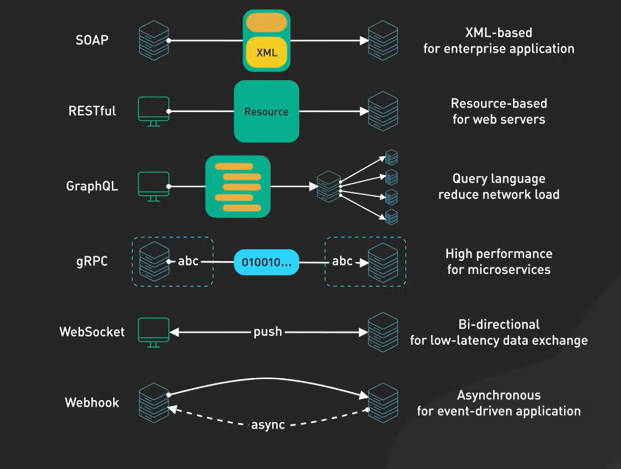
API Architecture Styles
GraphQL - let's clients fetch only the data they need, which avoids over-fetching or under-fetching of data.

Slide 10
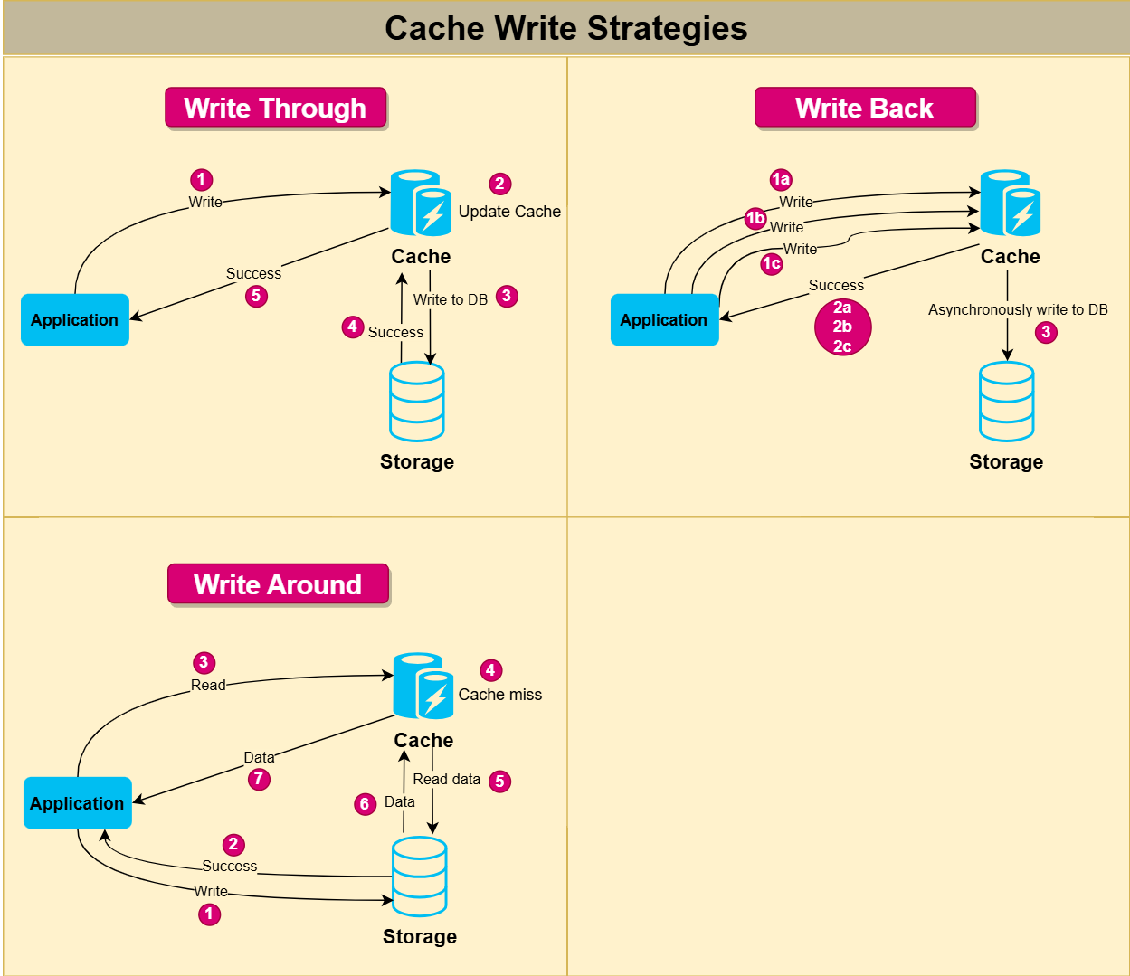
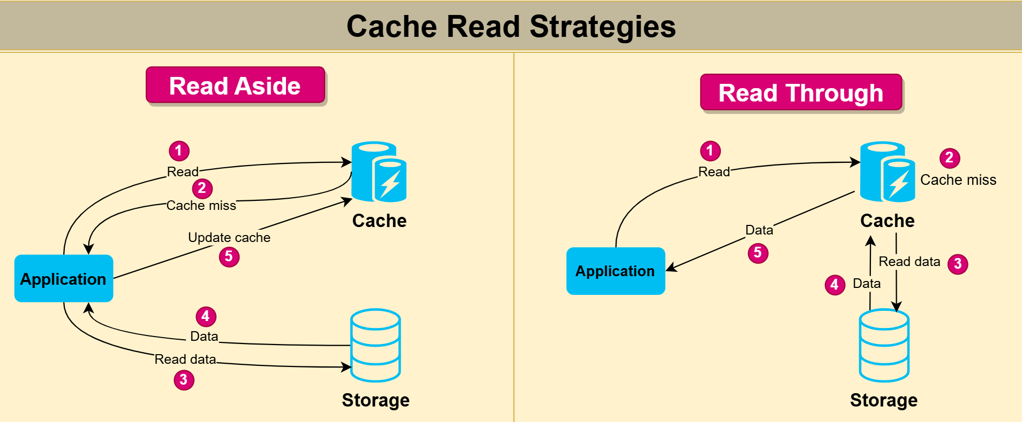
Caching
Write Through Read Through
Write Back Read Aside
Write Around Read Through (Most common)
Write Around Read Aside

Slide 11
Data

Slide 12
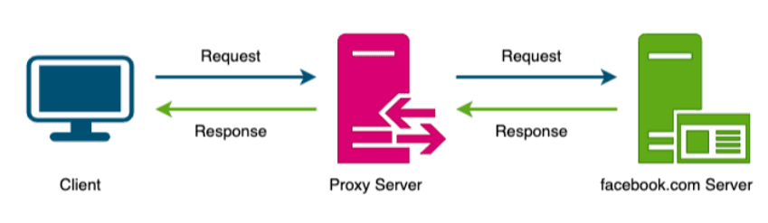
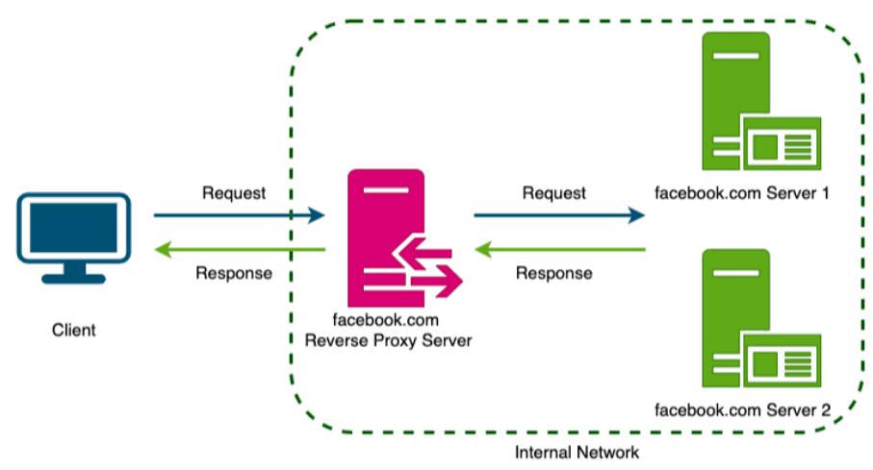
Proxy
A forward proxy can hide the identity of the client from the server by sending requests on behalf of the client. Example : Squid, ProxySG
Reverse proxy hides the server's identity. Example : Nginx, HAProxy

Slide 13
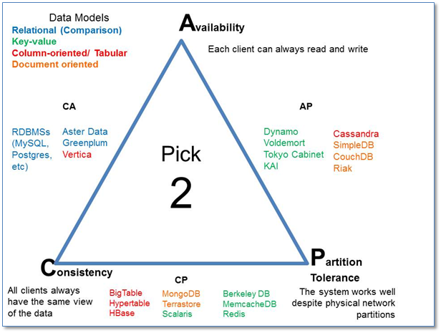
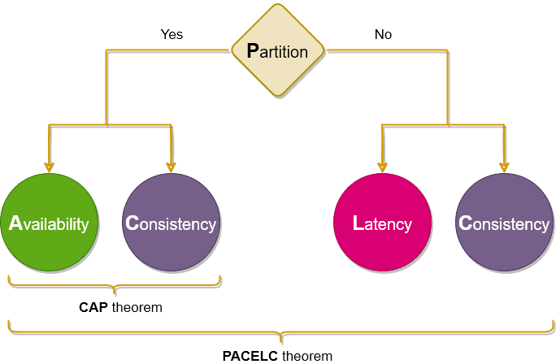
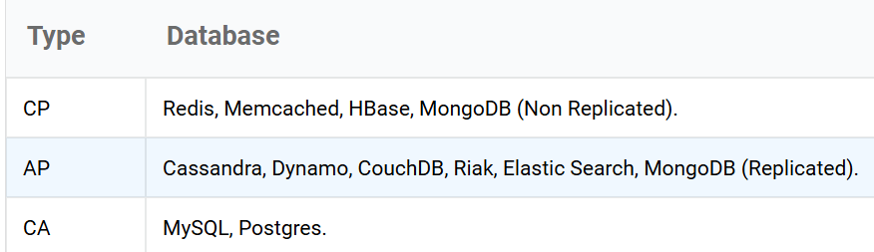
CAP Theorem in databases

Slide 14
Consistent Hashing
Is used for load balancing, data distribution, caching etc.
Hash Functions are any functions that map value from an arbitrarily sized domain to another fixed-sized domain. modulo N restricts hashed domain to a range [0, N-1]. This range will be used as consistent hashing circular ring
Requests are hashed to find a corresponding position on the ring. h(r1) = v1, h(r2) = v2 etc. Similarly, server ids can also be hashed with the same hash function (or different function) to find a position on the ring. h(s1) = v3, h(s2) = v4 etc.
For a value v we find the nearest server s (clockwise) on the ring!
Adding new node and removing existing node doesn’t require too much data redistribution.
The above works theoretically with the assumption that requests gets evenly distributed with the hash function. But practically we often see skewed distribution.
To solve this we can use virtual servers (or Vnode) instead of physical server to map requests. The idea is to create virtual id v in the ring which maps to a physical server. This way we achieve more uniform distribution as well lesser impact when adding/removing nodes
https://www.youtube.com/watch?v=zaRkONvyGr8

Slide 15

Bloom filter
In computing, a Bloom filter is a space-efficient probabilistic data structure
returns either "possibly in set" or "definitely not in set".
False positive matches are possible,
false negatives are not
Have a bit array of m bits
And k hash functions
Say we have 3 hash functions (and mod of that) will set bits 1, 4, and 7
h1(“data”) % 10 = 1
h2(“data”) % 10 = 4
h3(“data”) % 10 = 7
When searching for “data” we apply the same hash functions and check the bits.
If all the bits are set then we can say that “data” is probably present.
If any of the bit at these indices are 0 then “geeks” is definitely not present.
Example :
New email signup, check if an email already exists!
One-hit-wonders are web objects requested by users just once, Using a Bloom filter to detect the second request for a web object and caching that object only on its second request prevents one-hit wonders from entering the disk cache, significantly reducing disk workload and increasing disk cache hit rates

Slide 16
Write Ahead Log
In computer science, write-ahead logging (WAL) is a family of techniques for providing atomicity and durability (two of the ACID properties) in database systems.^{[1]}
The main functionality of a write-ahead log can be summarized as:^{[3]}
Allow the page cache to buffer updates to disk-resident pages while ensuring durability semantics in the larger context of a database system.
Persist all operations on disk until the cached copies of pages affected by these operations are synchronized on disk. Every operation that modifies the database state has to be logged on disk before the contents on the associated pages can be modified
Allow lost in-memory changes to be reconstructed from the operation log in case of a crash.
https://www.youtube.com/watch?v=wI4hKwl1Cn4

Slide 17
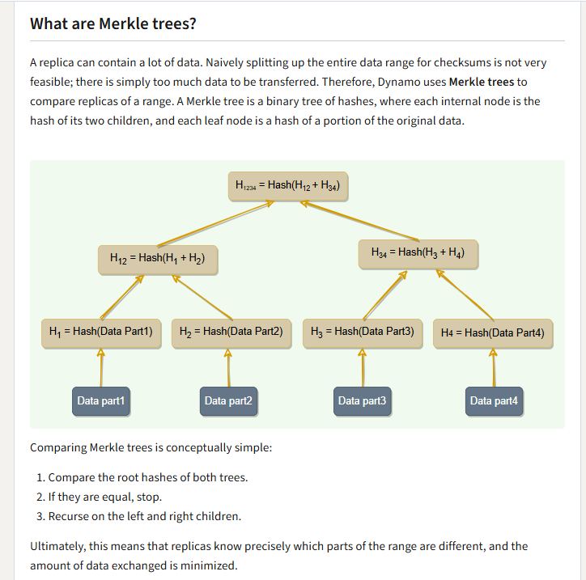

Slide 18
Quorum
mechanism used to ensure data consistency and availability by requiring a minimum number of nodes (a "quorum") to agree on an operation before it is considered successful.
Examples of quorum-based systems:
Apache Cassandra and Apache ZooKeeper utilize quorum-based approaches for data consistency and coordination.
Paxos and Raft are consensus algorithms that rely on quorum principles to achieve agreement among distributed nodes.
The Raft consensus algorithm utilizes a mechanism that is conceptually similar to a Write-Ahead Log (WAL) to ensure data durability and consistency in a distributed system. While a WAL primarily focuses on durability and crash recovery within a single database or system, Raft's log is central to achieving distributed consensus and replication across multiple nodes in a cluster. Use cases : Distributed Databases, Distributed Key-Value Stores, Service Discovery and Configuration Management, Distributed Messaging Systems etc
https://www.youtube.com/watch?v=IujMVjKvWP4

Slide 19
URL shortening - TinyURL
FR
Shorten URL
Redirect to original link
Custom short link
Expiration
Highlights
We can use a hash function to shorten an arbitrary length URL to a fixed size URL
Avoid hash collisions using Pre-generated Short URLs
We have to redirect requests with http response 301, 302, 308

Slide 20
Image sharing - Instagram
FR
Upload Photos
Search user
follow other users.
News Feed
NFR
1B DAU
Upload 1 photo / day
Highly Available 99.99%
Performance 500ms @ 99th percentile
Highlights:
Updating timeline of each user whenever there is an Influencer posts stresses the Timeline service. Instead we can store them in separate KV store say Influencer posts. Timeline service can merge them when responding to a user’s timeline request.

Slide 21
Dropbox
Highlights
The client application requests a Presigned URL from the Upload Service. The server generates the Presigned URL by interacting with the S3 service, creating a unique token for the specific upload operation. These URLs grant temporary, secure access to upload a specific file to a designated S3 bucket. Allows clients to bypass the server for direct communication with the storage layer.
FR
upload files
download files
share files
synchronize the data between user all devices
NFR
1M DAU
Upload 10 files
Each of 100mb
Total 1M gb /day

Slide 22
Instant Messaging
Highlights
P2P vs Chat Server
Polling vs bidirectional sockets
But we need a connection manager service as well to keep track which client is connected to which server
FR
1-to-1 direct messages
Group messages
Online/offline users
chat history
NFR
500M DAU
each user sends 40 messages daily; this gives us 20 billion messages per day.
20 billion messages * 100 bytes => 2 TB/day
 | Advantages | Disadvantages
P2P | Doesn’t stress the central platform | Concurrent connections in group chats might overwhelm the node Offline users don’t get the messages
Centralized approach | Offline users | Costly and bit slower

Slide 23
Twitter (X)
FR
Tweet (text, image, video)
Follow other users
New Feed
NFR
200M DAU
each reads an average of 100 tweets per day. That’s around 200M * 100 = 2B reads daily.
average 10 tweets per user per day, that’s 200M * 10 = 2B new tweets daily.
Each tweet size can be 1KB on average if it’s text-only
200M * 1MB = 20 petabytes of data read daily.
Highlights
Read heavy system. Important to separate read database vs write database

Slide 24
YouTube
FR
Upload videos (with metadata)
Watch videos
Search
Recommendations
NFR
1B DAU
1:100 upload : watch
50M uploads
Availability over Consistency
Minimize buffering
Highlights
Encoding 50M uploads / day ???
Videos are loaded in chunks when watched
Adaptive Bit rate to minimize buffering
CDN

Slide 25
Google Type Ahead Suggestion
FR
suggest top k terms starting with whatever the user has typed
NFR
5B daily searches
Highlights
Use a Trie
Instead of evaluating the trie for every request we can store Top k suggestions at each node
We can store the trie in distributed memory database (like Redis)

Slide 26
Uber/Lyft
Highlights
Driver Service will use WebSocket to update location every 5 sec. Once a ride is accepted, rider will also connect with WebSocket to get near real time updates of the driver.
Instead of using Lat/Long to find the distance between two points we use ….. Geohash is a base 32 alphanumeric system that divides the earth into 32 regions recursively. 6 chars are enough to represent a 1-2km area. Now we can quickly find adjacent areas because they will share the same first few chars. Example : a1b2c3 could be adjacent to a1b2c4
FR
Drivers need to regularly notify the service about their current location
Passengers get to see all the nearby available drivers.
Customer can request a ride
driver and a customer accept a ride
driver marks the journey complete
NFR
1M daily rides

Slide 27
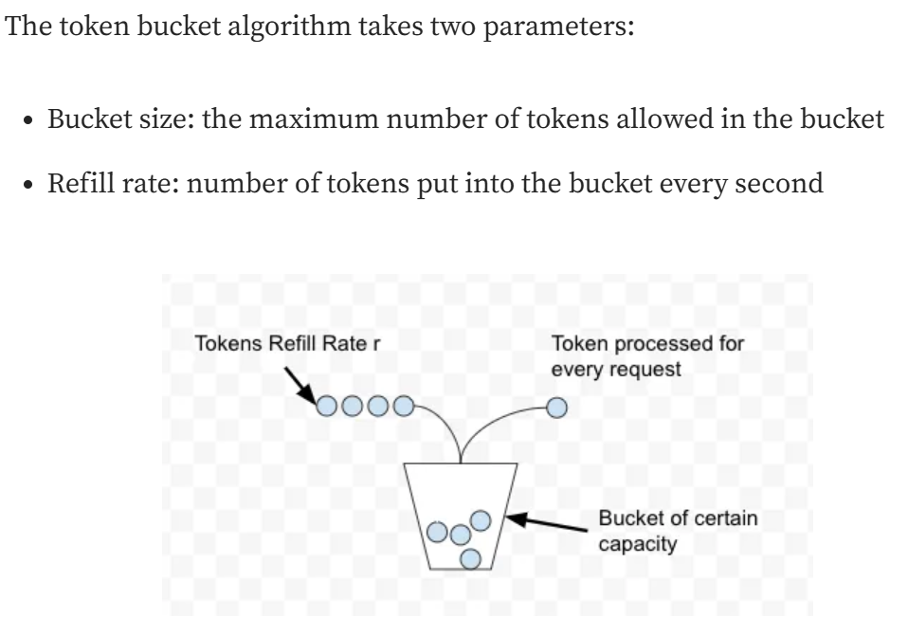
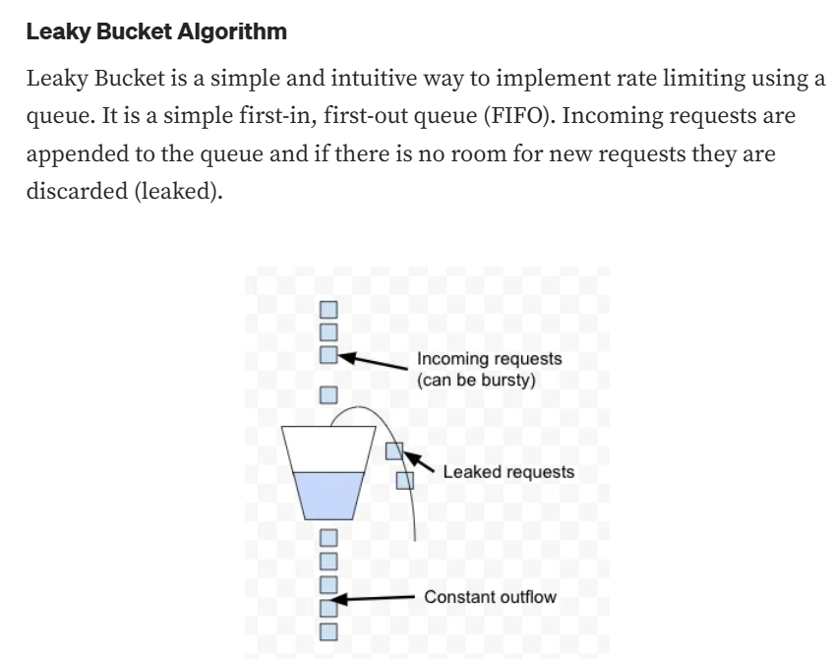
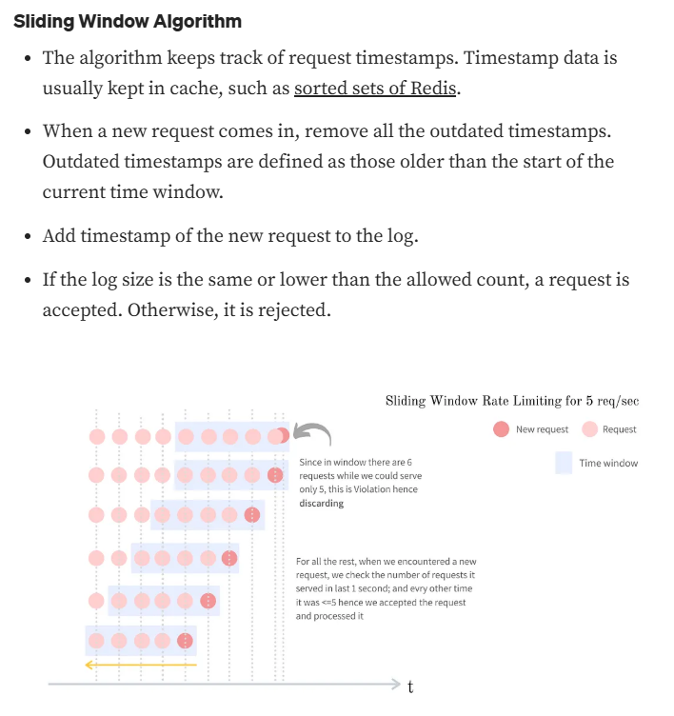
Rate Limiter
FR
limits the number of client requests allowed to be sent over a specified period. If the API request count exceeds the threshold defined by the rate limiter, all the excess calls are blocked (Returns a 429 response Too many requests)

Slide 28
Ticketmaster
Highlights
Avoid Conflict Free Booking :
Bad Solution : optimistic locking like SELECT FOR UPDATE
Great Solution : status of any given ticket is the combination of two attributes: whether it’s Available OR whether it's been reserved but the TTL has expired.
Great Solution : Distributed lock management using Redis. The Booking Service will lock that ticket by adding it to our Redis Distributed Lock with a TTL of 10 minutes
Seat Map : for popular events, the loaded seat map will go stale quickly.
To ensure that the seat map is always up to date, we can use Server-Sent Events (SSE) to push updates to the client in real-time.
For extremely popular events, we can implement an admin enabled virtual waiting queue system to manage user access during times of exceptionally high demand. (Taylor Swift case)
FR
show the user the seating arrangement of the cinema hall
user should be able to choose a particular event and book their tickets.
user should be able to distinguish available seats from booked ones.
Users should be able to put a hold on the seats for five minutes before they make a payment to finalize the booking.
NFR
1M daily rides
https://www.hellointerview.com/learn/system-design/problem-breakdowns/ticketmaster

Slide 29
DynamoDB
Highlights
1> How to partition and query the data?
Partition Key : unique identifier that determines items physical storage location through hashing (say Consistent Hashing)
Sort Key : (Optional) Secondary attribute that enables ordering and range queries within a partition. We can have a Btree index for this.
Primary Key : Partition Key : Sort Key
Local Secondary Index : Same partition key as the original table but different sort key
Global Secondary Index : Different partition key from table to query by any other attribute. (Similar to an index in RDBMS).
2> Eventually Consistency is default in DynamoDB. Which means each writes to a leader is eventually replicated to read replicase. But we can choose Strong Consistency instead of this, which means reads are from the leader node only (performance lags)
https://www.youtube.com/watch?v=2X2SO3Y-af8

Slide 30
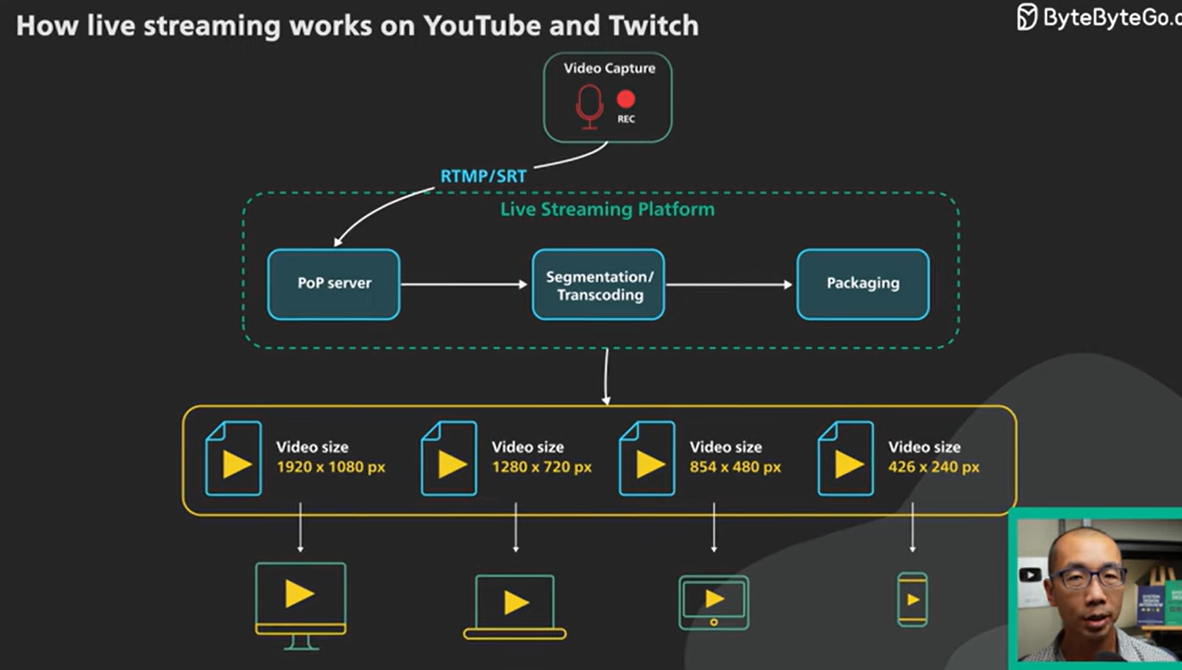
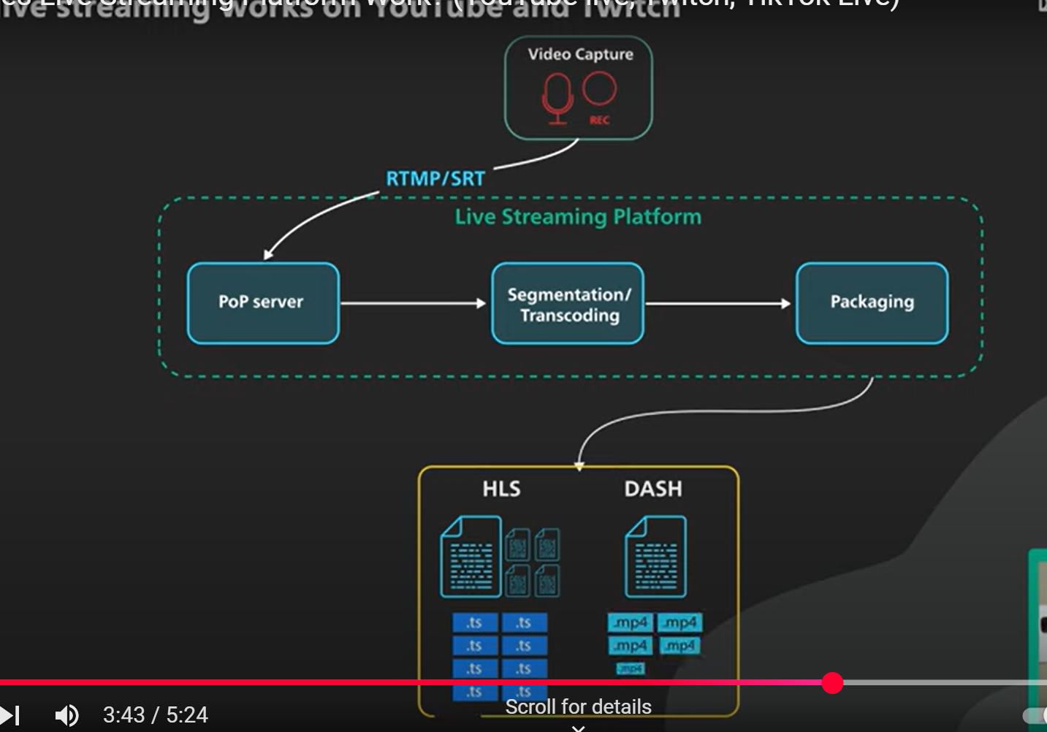
Live Streaming
Highlights
RTMP (TCP based) – Real Time Messaging Platform
SRT (UDP based) – Secure Reliable Transport. Not adopted widely yet
Transcoded to different resolutions and bit rates
Segmentation chunks them into smaller pieces
Packaging packs these to different formats that the video players can understand like HLS or DASH
HLS – HTTP Live Streaming (manifest and video chunks)
DASH - Dynamic Adaptive Streaming over HTTP
Glass to glass latency of 20 seconds is normal
https://www.youtube.com/watch?v=7AMRfNKwuYo

Slide 31
References
https://www.designgurus.io/course-play/grokking-the-system-design-interview/doc/what-is-a-system-design-interview
https://www.nexsoftsys.com/articles/CAP-theorem-database-dbms.html
https://stackoverflow.com/questions/12346326/cap-theorem-availability-and-partition-tolerance

